Slide 1
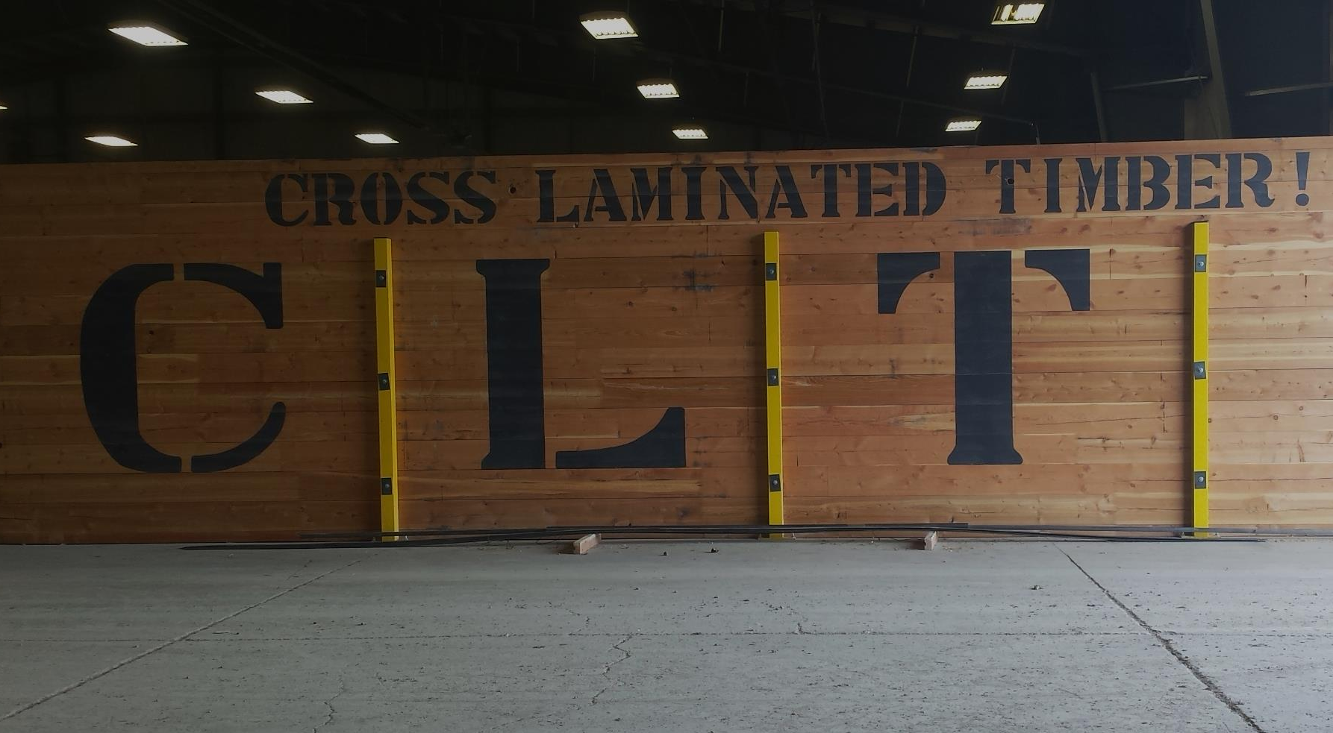
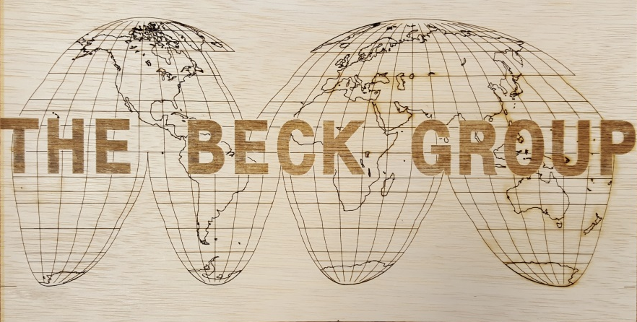
A CLT Manufacturing Plant: If you build it will the lumber come?
The Beck Group Forest Products Planning & Consulting www.beckgroupconsulting.com
Roy Anderson PhD, Vice President roya@beckgroupconsulting.com 503-684-3406

Slide 2
The Beck Group
In Business Since 1981
Consulting & Planning Services for the Forest Products Industry
Lumber
CLT/panels/engineered wood
Pellets
Biomass
Broad geographic experience
U.S. West, U.S. South, Lake States, Alaska
Canada
Overseas
Portland, Oregon
www.beckgroupconsulting.com
503-684-3406

Slide 3
U.S. Lumber Balance (Billion BF)
 | 2006 | 2007 | 2008 | 2009 | 2010 | 2011 | 2012 | 2013 | 2014 | 2015
Production | 38.7 | 35.2 | 29.2 | 23.4 | 24.8 | 26.5 | 28.3 | 30.0 | 31.6 | 32.0
- West | 18.0 | 16.3 | 13.0 | 10.4 | 11.1 | 11.6 | 12.6 | 13.5 | 14.1 | 14.0
- South | 18.7 | 17.0 | 14.6 | 11.8 | 12.4 | 13.5 | 14.3 | 15.0 | 16.1 | 16.6
- Other | 2.0 | 1.9 | 1.5 | 1.3 | 1.3 | 1.4 | 1.4 | 1.5 | 1.5 | 1.4
Imports | 22.8 | 18.4 | 12.7 | 8.9 | 9.5 | 9.3 | 9.9 | 11.4 | 12.7 | 14.0
Canadian | 20.1 | 16.7 | 11.6 | 8.3 | 9.0 | 8.8 | 9.5 | 10.9 | 12.1 | 13.3
Non-Canadian | 2.7 | 1.7 | 1.1 | 0.6 | 0.4 | 0.4 | 0.3 | 0.4 | 0.6 | 0.7
Exports | 0.9 | 1.0 | 1.0 | 1.0 | 1.3 | 1.7 | 1.6 | 1.8 | 1.7 | 1.6
Net Trade | -21.9 | -17.4 | -11.7 | -7.9 | -8.1 | -7.6 | -8.3 | -9.6 | -11.0 | -12.4
Apparent Consumption | 60.6 | 52.6 | 40.8 | 31.3 | 32.9 | 34.1 | 36.5 | 39.6 | 42.6 | 44.4
Source: Western Wood Products Association

Slide 4
U.S. Lumber Balance (Billion BF)
 | 2006 | 2007 | 2008 | 2009 | 2010 | 2011 | 2012 | 2013 | 2014 | 2015
Production | 38.7 | 35.2 | 29.2 | 23.4 | 24.8 | 26.5 | 28.3 | 30.0 | 31.6 | 32.0
- West | 18.0 | 16.3 | 13.0 | 10.4 | 11.1 | 11.6 | 12.6 | 13.5 | 14.1 | 14.0
- South | 18.7 | 17.0 | 14.6 | 11.8 | 12.4 | 13.5 | 14.3 | 15.0 | 16.1 | 16.6
- Other | 2.0 | 1.9 | 1.5 | 1.3 | 1.3 | 1.4 | 1.4 | 1.5 | 1.5 | 1.4
Imports | 22.8 | 18.4 | 12.7 | 8.9 | 9.5 | 9.3 | 9.9 | 11.4 | 12.7 | 14.0
Canadian | 20.1 | 16.7 | 11.6 | 8.3 | 9.0 | 8.8 | 9.5 | 10.9 | 12.1 | 13.3
Non-Canadian | 2.7 | 1.7 | 1.1 | 0.6 | 0.4 | 0.4 | 0.3 | 0.4 | 0.6 | 0.7
Exports | 0.9 | 1.0 | 1.0 | 1.0 | 1.3 | 1.7 | 1.6 | 1.8 | 1.7 | 1.6
Net Trade | -21.9 | -17.4 | -11.7 | -7.9 | -8.1 | -7.6 | -8.3 | -9.6 | -11.0 | -12.4
Apparent Consumption | 60.6 | 52.6 | 40.8 | 31.3 | 32.9 | 34.1 | 36.5 | 39.6 | 42.6 | 44.4
Source: Western Wood Products Association

Slide 5
U.S. Lumber Balance (Billion BF)
 | 2006 | 2007 | 2008 | 2009 | 2010 | 2011 | 2012 | 2013 | 2014 | 2015
Production | 38.7 | 35.2 | 29.2 | 23.4 | 24.8 | 26.5 | 28.3 | 30.0 | 31.6 | 32.0
- West | 18.0 | 16.3 | 13.0 | 10.4 | 11.1 | 11.6 | 12.6 | 13.5 | 14.1 | 14.0
- South | 18.7 | 17.0 | 14.6 | 11.8 | 12.4 | 13.5 | 14.3 | 15.0 | 16.1 | 16.6
- Other | 2.0 | 1.9 | 1.5 | 1.3 | 1.3 | 1.4 | 1.4 | 1.5 | 1.5 | 1.4
Imports | 22.8 | 18.4 | 12.7 | 8.9 | 9.5 | 9.3 | 9.9 | 11.4 | 12.7 | 14.0
Canadian | 20.1 | 16.7 | 11.6 | 8.3 | 9.0 | 8.8 | 9.5 | 10.9 | 12.1 | 13.3
Non-Canadian | 2.7 | 1.7 | 1.1 | 0.6 | 0.4 | 0.4 | 0.3 | 0.4 | 0.6 | 0.7
Exports | 0.9 | 1.0 | 1.0 | 1.0 | 1.3 | 1.7 | 1.6 | 1.8 | 1.7 | 1.6
Net Trade | -21.9 | -17.4 | -11.7 | -7.9 | -8.1 | -7.6 | -8.3 | -9.6 | -11.0 | -12.4
Apparent Consumption | 60.6 | 52.6 | 40.8 | 31.3 | 32.9 | 34.1 | 36.5 | 39.6 | 42.6 | 44.4
1 Large CLT Plant = 24 Million board feet/yr.
All of 2015 Western U.S. Softwood Lumber Production could supply nearly 600 CLT plants that size???
Source: Western Wood Products Association

Slide 6
CLT Manufacturing: Lumber Specifications
Species
Grades
Size (width, thickness, length)
Moisture Content

Slide 7
CLT Supply: Species
Any softwood species recognized by the American Lumber Standards Committee with specific gravity of 0.35 or greater
Only 1 species per CLT layer, adjacent layers can be different species
Species | Specific Gravity | Species | Specific Gravity
Longleaf pine | 0.54 | Eastern white pine | 0.34
Slash pine | 0.54 | Balsam fir | 0.33
Western larch | 0.48 | Engelmann spruce | 0.33
Loblolly pine | 0.47 | White spruce | 0.33
Douglas fir | 0.45 | Subalpine fir | 0.31
Western hemlock | 0.42 | Western red cedar | 0.31
Red Pine | 0.41
Jack pine | 0.40
Lodgepole pine | 0.38
Ponderosa pine | 0.38
Black spruce | 0.38
Sitka spruce | 0.37
Grand fir | 0.35
White fir | 0.37 | Source: Measurement of Roundwood, M.A. Fonseca

Slide 8
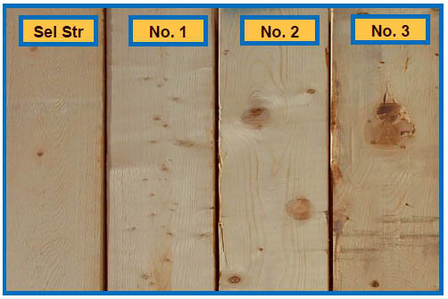
CLT Lumber Grades
Structural Dimension Lumber Grade
Parallel layers: #2 or better (visual grading) or MSR 1200f or better (machine grading)
Perpendicular layers: #3 or better
Source: ANSI/APA PRG 320-2012

Slide 9
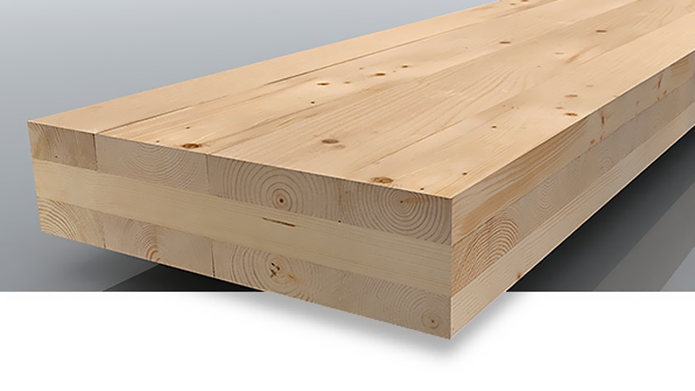
CLT Lumber Sizes
Thickness not less than 5/8” or greater than 2”
Major Strength Direction (parallel): net width not less than 1.75 times the thickness
Minor Strength Direction (perpendicular): net width not less than 3.5 times the thickness
Parallel
Parallel
Perpendicular
Source: ANSI/APA PRG 320-2012

Slide 10
CLT Lumber Sizes
Thickness not less than 5/8” or greater than 2”
Major Strength Direction (parallel): net width not less than 1.75 times the thickness
Minor Strength Direction (perpendicular): net width not less than 3.5 times the thickness
Parallel
Nominal Size (inches) | Actual thickness (inches) | Actual width (inches) | Ratio (width to thickness)
1x2 | 0.75 | 1.50 | 2.00
1x3 | 0.75 | 2.50 | 3.33
1x4 | 0.75 | 3.50 | 4.67
1x6 | 0.75 | 5.50 | 7.33
2x2 | 1.50 | 1.50 | 1.00
2x3 | 1.50 | 2.50 | 1.67
2x4 | 1.50 | 3.50 | 2.33
2x6 | 1.50 | 5.50 | 3.67
2x8 | 1.50 | 7.25 | 4.83
2x10 | 1.50 | 9.25 | 6.17
2x12 | 1.50 | 11.25 | 7.50
Perpendicular
Nominal Size (inches) | Actual thickness (inches) | Actual width (inches) | Ratio (width to thickness)
1x2 | 0.75 | 1.50 | 2.00
1x3 | 0.75 | 2.50 | 3.33
1x4 | 0.75 | 3.50 | 4.67
1x6 | 0.75 | 5.50 | 7.33
2x2 | 1.50 | 1.50 | 1.00
2x3 | 1.50 | 2.50 | 1.67
2x4 | 1.50 | 3.50 | 2.33
2x6 | 1.50 | 5.50 | 3.67
2x8 | 1.50 | 7.25 | 4.83
2x10 | 1.50 | 9.25 | 6.17
2x12 | 1.50 | 11.25 | 7.50

Slide 11
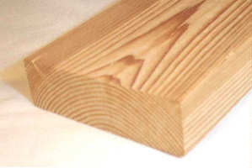
CLT Lumber Moisture Content
Moisture content at time of CLT manufacturing shall be 12% +/- 3%
Wood shrinks at different rates in different planes (percent shrinkage)
Tangential (8%)
Radial (4%)
Longitudinal (0.01%)
Source: ANSI/APA PRG 320-2012
Notes:
Explain trees average roughly 50 percent moisture
As MC drops below 30% shrinkage starts to occure
Most wood in service equilibrates at about 10 to 12% MC

Slide 12
CLT Manufacturing: Real World Implications of CLT Lumber Specifications
Species
Grades
Size (width, thickness, length)
Moisture Content
How is lumber availability and CLT manufacturing cost affected by these factors?

Slide 13
CLT Manufacturing Process
Lumber inspection
Defect removal and finger-jointing
Cut to length
Surfacing
Panel layup
Pressing
Sizing/finish
Shipping
Linear process: bigger pieces = greater productivity
Greater productivity = lower cost

Slide 14
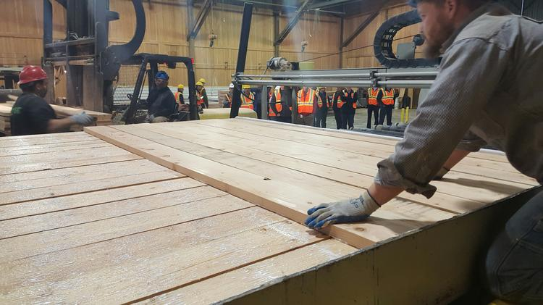
CLT Manufacturing Process
Lumber inspection
Defect removal and finger-jointing
Cut to length
Surfacing
Panel layup
Pressing
Sizing/finish
Shipping
bigger pieces =
less layup time = lower cost

Slide 15
CLT Manufacturing: Lumber Cost
$/MBF, Coast, Kiln Dry, Douglas fir, #2&btr, random length, net f.o.b. mill
bigger pieces =
less layup time = lower cost
Source: Random Lengths

Slide 16
CLT Manufacturing: Lumber Cost
2 x 4 = $314
2 x 6 = $315
2 x 8 = $301
2 x 10 = $341
2 x 12 = $369
Therefore, use #2&Btr 2 x 8 because it offers the best comprise of large piece size and low cost
bigger pieces =
less layup time = lower cost

Slide 17
CLT Manufacturing: Lumber Availability
Sizes | Product Size Distribution | Grades | Product Grade Distribution
2x4 | 35% | Premium | 38%
2x6 | 31% | #2 & btr | 49%
2x8 | 11% | #3 (Utility) | 4%
2x10 | 12% | #4 (Economy) | 5%
2x12 | 9% | Export | 2%
Other | 2% | Other | 2%
 | 100% |  | 100%
bigger pieces =
less layup time = lower cost
Source: BECK Benchmarking Data, Western Dimension Mills (2013)

Slide 18
CLT Manufacturing: Lumber Availability
Average Western U.S. dimension mill annual capacity ~ 180 MMBF/year
Therefore, if 11% is 2x8 then about 19.8 MMBF of 2x8 is produced/year
And, if 49% is #2&btr then about 9.7 MMBF is produced/year
Conclusion, best to have two to three and preferably 4 or more nearby mills to provide the 24 million board feet of lumber needed per year.
bigger pieces =
less layup time = lower cost
Source: BECK Benchmarking Data, Western Dimension Mills (2013)

Slide 19
CLT Manufacturing: Lumber Availability
What about Moisture Content?
Current standard practice is to dry to 19% MC
Current kiln schedules ~ 24 hours per charge
Longer kiln schedule to get to the 12% MC required for CLT, maybe as much as double the time needed?
Kilns are often the bottleneck at sawmilling operations
Therefore, sawmills may have little interest in drying lumber to a lower moisture content
In our analysis we’ve assumed a $50/MBF increased cost above published market prices to get lumber dried to 12% MC
bigger pieces =
less layup time = lower cost
Source: BECK Benchmarking Data, Western Dimension Mills (2013)

Slide 20
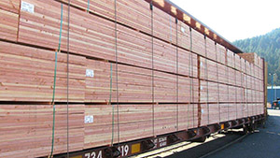
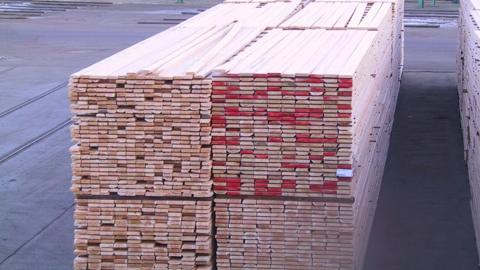
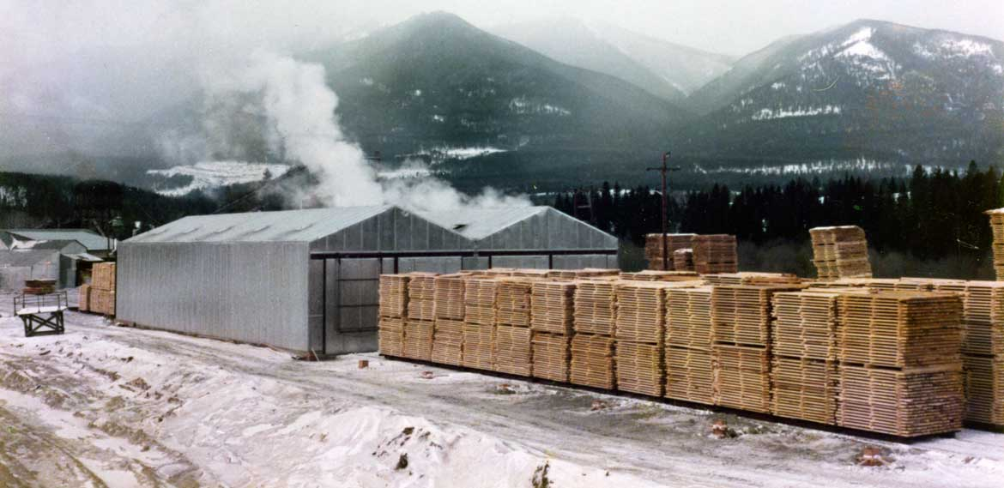
CLT Manufacturing: Lumber Availability
What about drying at CLT plant?
Lumber unit received
Unit broken apart and lumber placed on stickers
Kiln drying
Stickers removed
Lumber stacked in units
Also capital, fuel, operating, and maintenance costs for dry kilns
Our conclusion is: better to buy lumber already dried
bigger pieces =
less layup time = lower cost

Slide 21
Final Perspective on CLT Manufacturing Costs
Cost Category | Sawmill | CLT | Ply | OSB | PB | MDF
Wood | 66 | 52 | 45 | 30 | 21 | 16
Glue | 0 | 11 | 7 | 20 | 24 | 24
Labor | 9 | 8 | 23 | 8 | 12 | 8
Supplies | 7 | 4 | 7 | 9 | 8 | 9
Repairs & Maintenance | 4 | 2 | 4 | 4 | 5 | 4
Utilities | 3 | 3 | 5 | 6 | 10 | 17
Management Salaries | 3 | 5 | 2 | 7 | 6 | 5
SG&A | 7 | 16 | 7 | 17 | 14 | 17
Total | 100 | 100 | 100 | 100 | 100 | 100
*Percent of total manufacturing cost by natural expense cost classification
Source: Beck Group – Forest Products Industry Benchmarking Studies

